Slide 1
ANALOG-TO-DIGITAL AND DIGITAL-TO-ANALOG CONVERTERS

Slide 2
INTRODUCTION
An analog quantity is on that can take on any value over a continuous range of values. It represents an exact value.
Most physical variables are analog in nature.
Example: Temperature, pressure, light and sound intensity, position, rotation, speed, etc.
A digital quantity takes on only discrete values. The value is expressed in digital code such as a binary or BCD number.

Slide 3
When a physical process is monitored or controlled by a digital system such as a digital computer, the physical variables are first converted into electrical signals using transducers, and then these electrical analog signals are converted into digital signals using analog-to-digital converters (ADCs).

Slide 4
These digital signals are processed by a digital computer and the output of the digital computer is converted into analog signals using digital-to-analog-converters (DACs).
The output of the DAC is modified by an actuator and the output of the actuator is applied as the control variable.

Slide 5
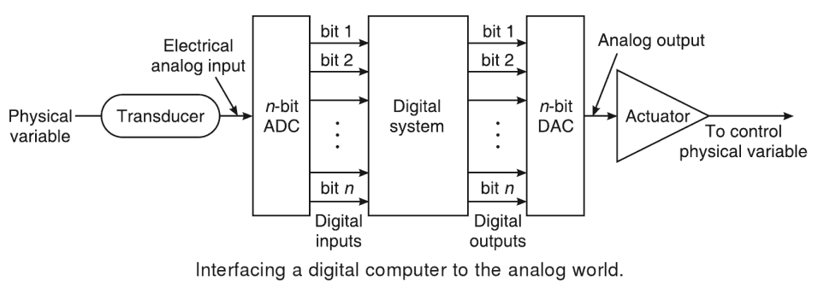
Figure shows how ADCs and DACs function as interfaces between a completely digital system such as digital computer and the analog world.

Slide 6
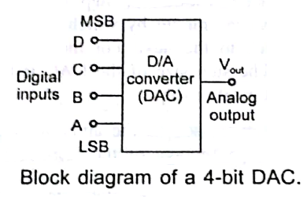
DIGITAL-TO-ANALOG (D/A) CONVERSION
Basically, D/A conversion is the process of converting a value represented in digital code, such as straight binary or BCD, into a voltage or current which is proportional to the digital value.
Figure shows the symbol for a typical 4-bit D/A converter.

Slide 7
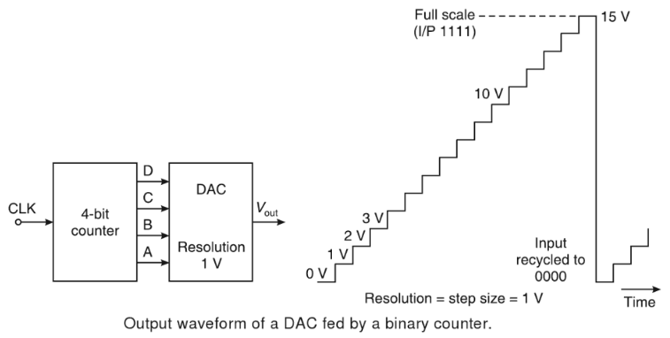
The analog output voltage V_{out} is proportional to the input binary number is,
Analog output = K × digital input
Where K is the proportionality factor and is a constant value for a given DAC.

Slide 8
Parameters of DAC
Resolution (step size)
Speed
Linearity
Settling Time
Reference Voltages
Errors

Slide 9
Resolution (step size)
The resolution of a DAC is defined as the smallest change that can occur in an analog output as a result of a change in the digital input.
The resolution of a DAC is also defined as the reciprocal of the number of discrete steps in the full-scale output of the DAC.
The resolution is always equal to the weight of the LSB and is also referred to as the step size.

Slide 10
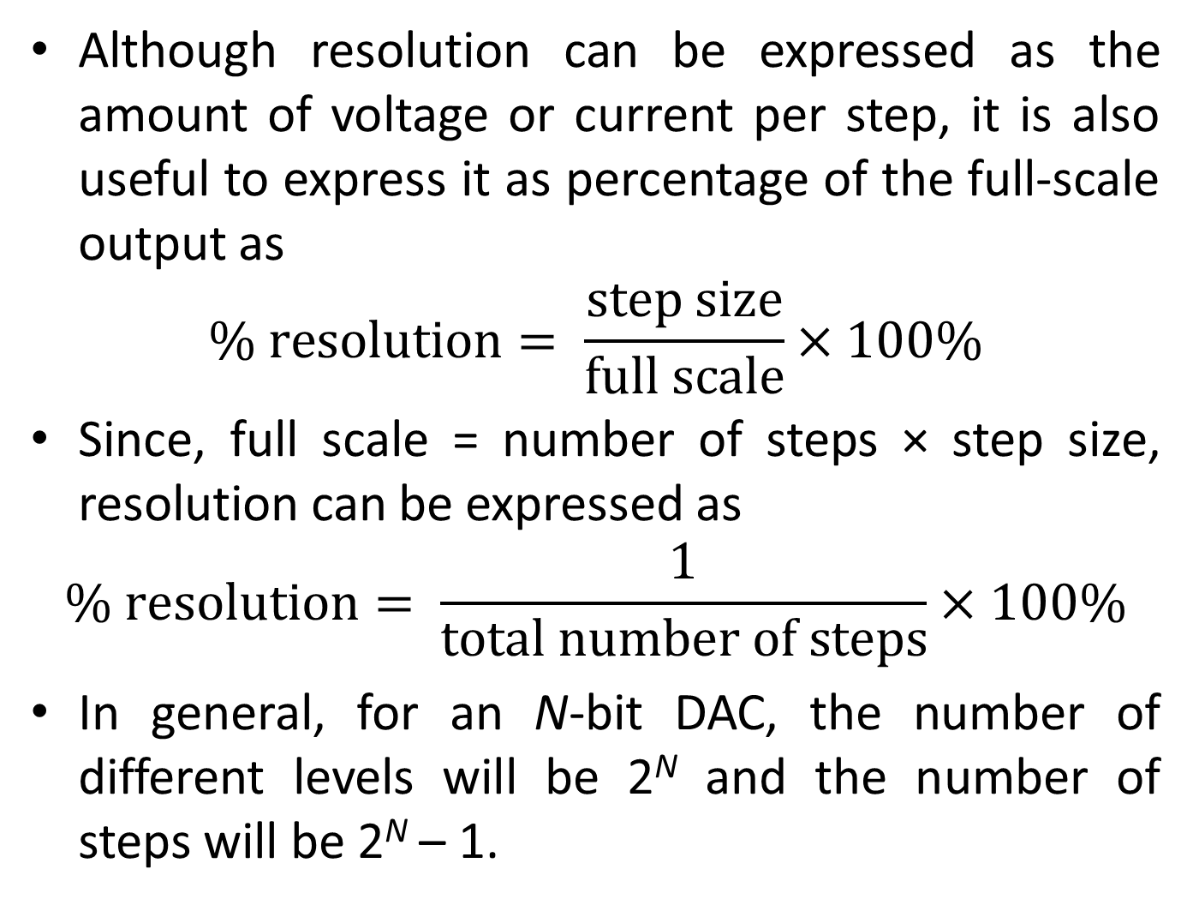

Slide 11
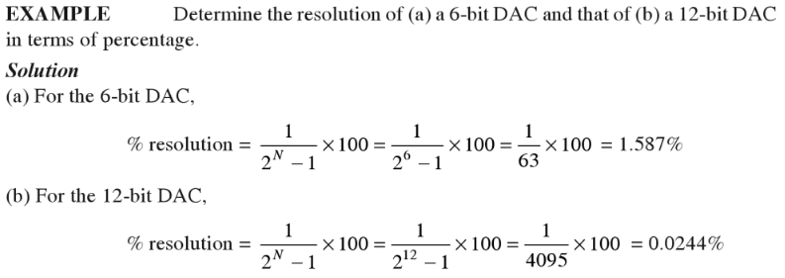
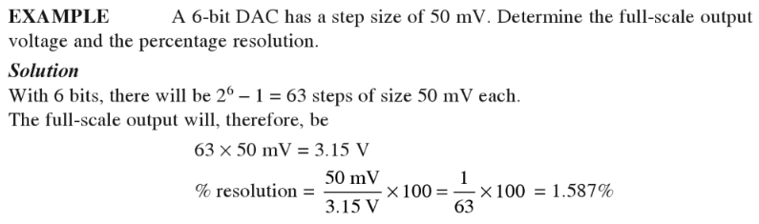

Slide 12
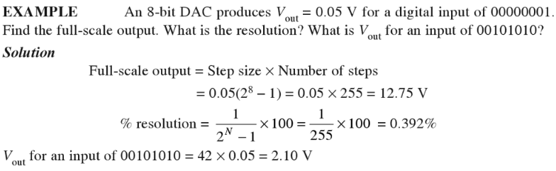

Slide 13
Speed
Rate of conversion of a single digital input to its analog equivalent.
Conversion rate depends on
  clock speed of input signal
  settling time of converter
When the input changes rapidly, the DAC conversion speed must be high.

Slide 14
Linearity
The difference between the desired analog output and the actual output over the full range of expected values.

Slide 15
Ideally, a DAC should produce a linear relationship between the digital input and analog output.
Linearity (Ideal)
Non-Linearity

Slide 16
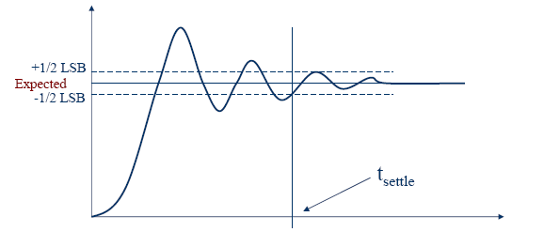
Settling Time
Time required for the output signal to settle within ± ½ LSB of its final value after a given change in input scale.
Limited by slew rate of output amplifier.
Ideally, an instantaneous change in analog voltage would occur when a new binary word enters into DAC.

Slide 17
Reference Voltages
Used to determine how each digital input will be assigned to each voltage division
Types:
  Non-multiplier DAC: V_{ref} is fixed
  Multiplier DAC: V_{ref} provided by external source

Slide 18
Types of Errors Associated with DACs
Gain
Offset
Full Scale
Resolution
Non-Linearity
Non-Monotonic
Settling Time and Overshoot

Slide 19
Gain Error
Occurs when the slope of the actual output deviates from the ideal output.

Slide 20
Offset Error
Occurs when there is a constant offset between the actual output and the ideal output.

Slide 21
Full Scale Error
Occurs when the actual signal has both gain and offset errors.

Slide 22
Resolution Error
Poor representation of ideal output due to poor resolution.
Size of voltage divisions affect the resolution.

Slide 23
Non-Linearity Error
Occurs when analog output of signal is non-linear.
Two Types
  Differential – analog step-sizes changes with increasing digital input (measure of largest deviation; between successive bits).
  Integral – amount of deviation from a straight line after offset and gain errors removed; on concurrent bits.

Slide 24
Non-Monotonic Error
Occurs when an increase in digital input results in a decrease in the analog output.

Slide 25
Settling Time and Overshoot Error
Settling Time – time required for the output to fall with in ± ½ V_{LSB.}
Overshoot – occurs when analog output overshoots the ideal output.
Analog Output
+1/2*V_{LSB}
Ideal Output
-1/2*V_{LSB}
Settling Time
Time

Slide 26
Types of DACs
Many types of DACs available.
Usually switches, resistors, and op-amps used to implement conversion.
Two Types:
  Binary Weighted Resistor Type DAC
  R-2R Ladder Type DAC

Slide 27
Binary Weighted Resistor Type DAC
Utilizes a summing op-amp circuit.
Weighted resistors are used to distinguish each bit from the most significant to the least significant.
Transistors are used to switch between V_{ref} and ground (bit high or low).

Slide 28
Assume Ideal Op-amp
No current into Op-amp
Virtual ground at inverting input
V_{out}= -IR_{f}
V_{ref}
R
I
Rf
2R
4R
-
V_{out}
+
2^{n}R

Slide 29
V_{ref}
Voltages V₁ through V_{n} are either V_{ref} if corresponding bit is high or ground if corresponding bit is low
V₁ is most significant bit
V_{n} is least significant bit
V₁
R
V₂
2R
I
Rf
V₃
4R
-
V_{out}
+
V_{n}
2^{n-1}R
MSB
LSB

Slide 30
If R_{f}=R/2
For example, a 4-Bit converter yields
Where b₃ corresponds to Bit-3, b₂ to Bit-2, etc.

Slide 31
Advantages
  Simple Construction/Analysis
  Fast Conversion
Disadvantages
  Requires large range of resistors (2000:1 for 12-bit DAC) with necessary high precision for low resistors
  Requires low switch resistances in transistors
  Can be expensive. Therefore, usually limited to 8-bit resolution.

Slide 32
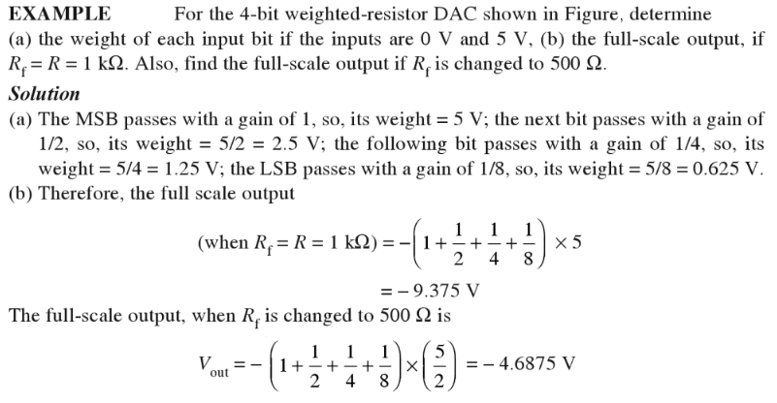

Slide 33
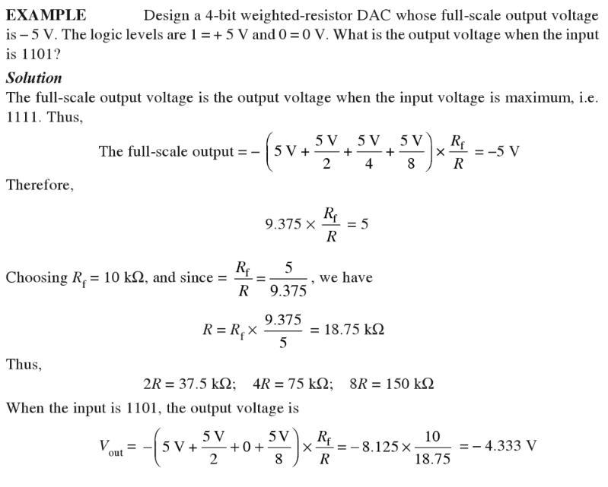

Slide 34
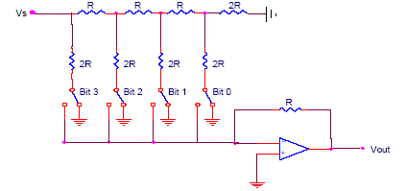
R-2R Ladder Type DAC
Each bit corresponds
to a switch:
If the bit is high,
the corresponding
switch is connected to
the inverting input of
the op-amp.
If the bit is low, the
corresponding switch
is connected to ground.
V_{ref}
Bit: 0 0 0 0
V_{out}
4-Bit Converter

Slide 35
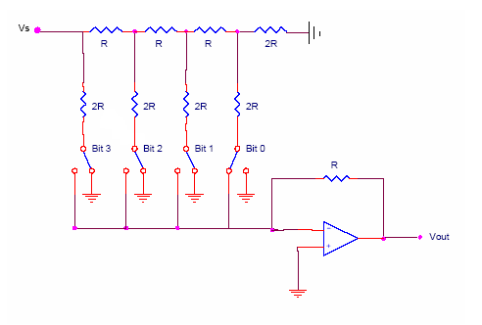
V₃
V_{ref}
V₁
V₂
V₃
Ideal Op-amp
2R
2R

Slide 36
V_{ref}
V₁
V₂
V₃
V₂
V₃
R
R
I
Likewise,
V_{out}

Slide 37
Results:
V_{ref}
V₁
V₂
V₃
Where b₃ corresponds to bit 3,
b₂ to bit 2, etc.
If bit n is set, b_{n}=1
If bit n is clear, b_{n}=0
V_{out}

Slide 38
For a 4-Bit R-2R Ladder
For general n-Bit R-2R Ladder or Binary Weighted Resister DAC

Slide 39
Advantages
  Only two resistor values (R and 2R)
  Does not require high precision resistors
Disadvantage
  Lower conversion speed than binary weighted DAC

Slide 40
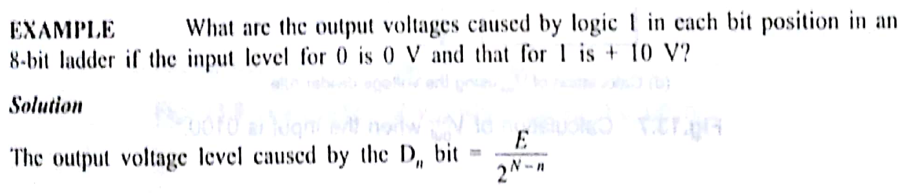
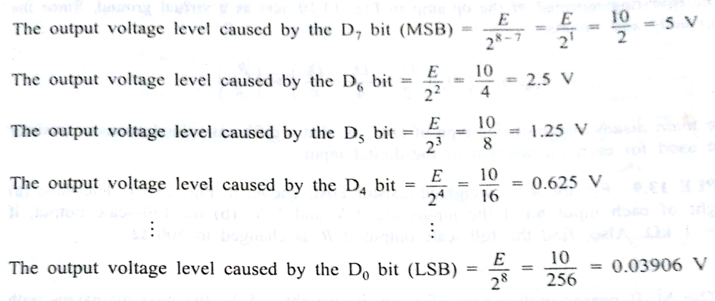

Slide 41
Applications of DAC
Digital Motor Control
Computer Printers
Sound Equipment (e.g. CD/MP3 Players, etc.)
Electronic Cruise Control
Digital Thermostat

Slide 42
ANALOG-TO-DIGITAL (A/D) CONVERSION
An electronic integrated circuit which transforms a signal from analog (continuous) to digital (discrete) form.
Analog signals are directly measurable quantities.
Digital Signals – have only two states. For digital computers, we refer to binary states, 0 and 1. “1” can be on, “0” can be off.

Slide 43
ADC process
Input analog signal
u_{I}(t)
Output digital signal
n-1
D
Quantizing & Encoding
…
S
u_{I}′(t)
D₁
C
D₀
S/H circuit
2 steps
Sampling and Holding (S/H)
Quantizing and Encoding (Q/E)

Slide 44
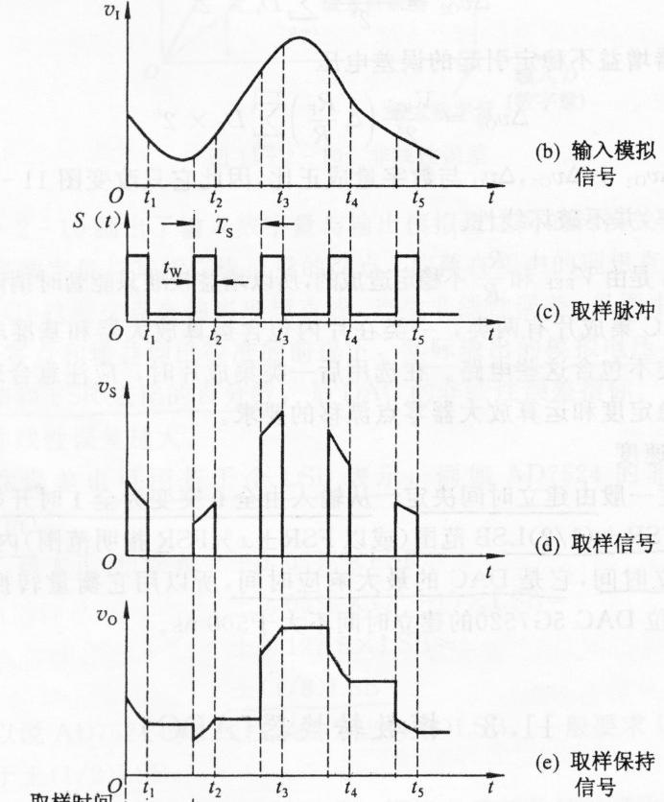
Sampling and Holding
Continuous Signal
Holding signal benefits the accuracy of the A/D conversion
Sampling pulse
Minimum sampling rate should be at least twice the highest data frequency of the analog signal
Sampled signal
Sampled and held signal

Slide 45
Quantizing and Encoding
Resolution:
The smallest change in analog signal that will result in a change in the digital output.
ΔV = ^{Vr}
₂N
V_{r} = Reference voltage range
N = Number of bits in digital output. 2^{N} = Number of states.
∆V = Resolution
The resolution represents the quantization error inherent in the conversion of the signal to digital form

Slide 46
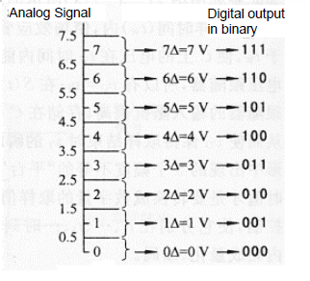
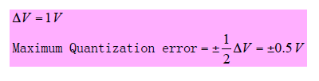
Quantizing:
Partitioning the reference signal range into a number of discrete quanta, then matching the input signal to the correct quantum.
Encoding:
Assigning a unique digital code to each quantum, then allocating the digital code to the input signal.

Slide 47
The number of possible states that the converter can output is:
N=2^{n}
where n is the number of bits in the AD converter
Example: For a 3 bit A/D converter, N=2³=8.
Analog quantization size:
Q=(Vmax-Vmin)/N = (10V – 0V)/8 = 1.25V

Slide 48
Accuracy of A/D Conversion
There are two ways to best improve the accuracy of A/D conversion:
increasing the resolution which improves the accuracy in measuring the amplitude of the analog signal.
increasing the sampling rate which increases the maximum frequency that can be measured.

Slide 49
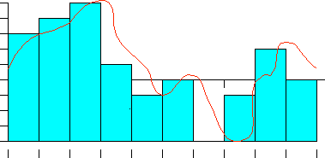
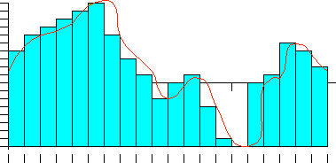
Low Accuracy  Improved
Time
Time
Resolution
Resolution

Slide 50
A/D Converter Types
  Flash type A/D Converter
  Delta-Sigma type A/D Converter
  Dual-Slope type A/D Converter
  Successive-Approximation type A/D Converter

Slide 51
Flash type A/D Converter
Consists of a series of comparators, each one comparing the input signal to a unique reference voltage.
The comparator outputs connect to the inputs of a priority encoder circuit, which produces a binary output

Slide 52
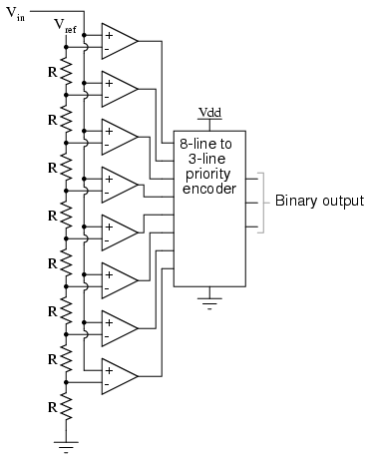
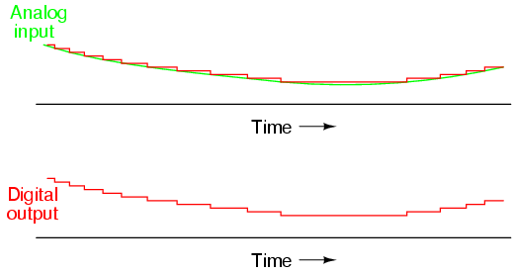

Slide 53
As the analog input voltage exceeds the reference voltage at each comparator, the comparator outputs will sequentially saturate to a high state.
The priority encoder generates a binary number based on the highest-order active input, ignoring all other active inputs.

Slide 54
Advantages
Simplest in terms of operational theory
Most efficient in terms of speed, very fast
    limited only in terms of comparator and gate propagation delays
Disadvantages
Lower resolution
Expensive
For each additional output bit, the number of comparators is doubled
    i.e. for 8 bits, 256 comparators needed

Slide 55
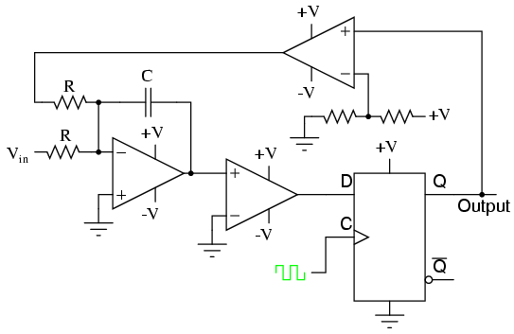
Sigma-Delta type A/D Converter
Over sampled input signal goes to the integrator
Output of integration is compared to GND
Iterates to produce a serial bit stream
Output is serial bit stream with # of 1’s proportional to V_{in}

Slide 56
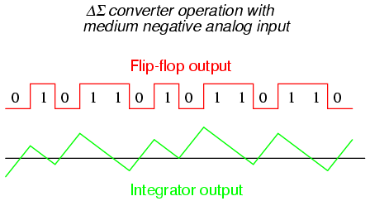
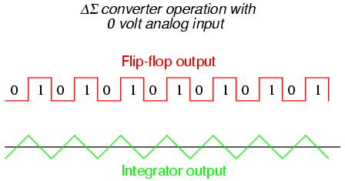
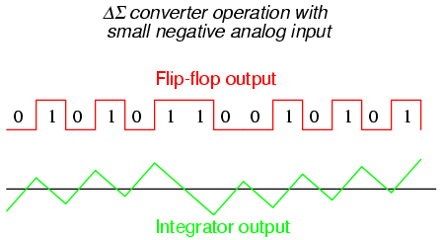
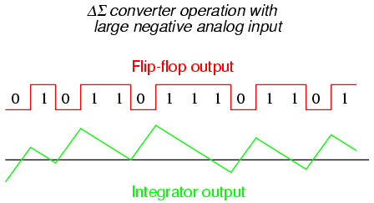

Slide 57
Advantages
High resolution
No precision external components needed
Disadvantages
Slow due to oversampling

Slide 58
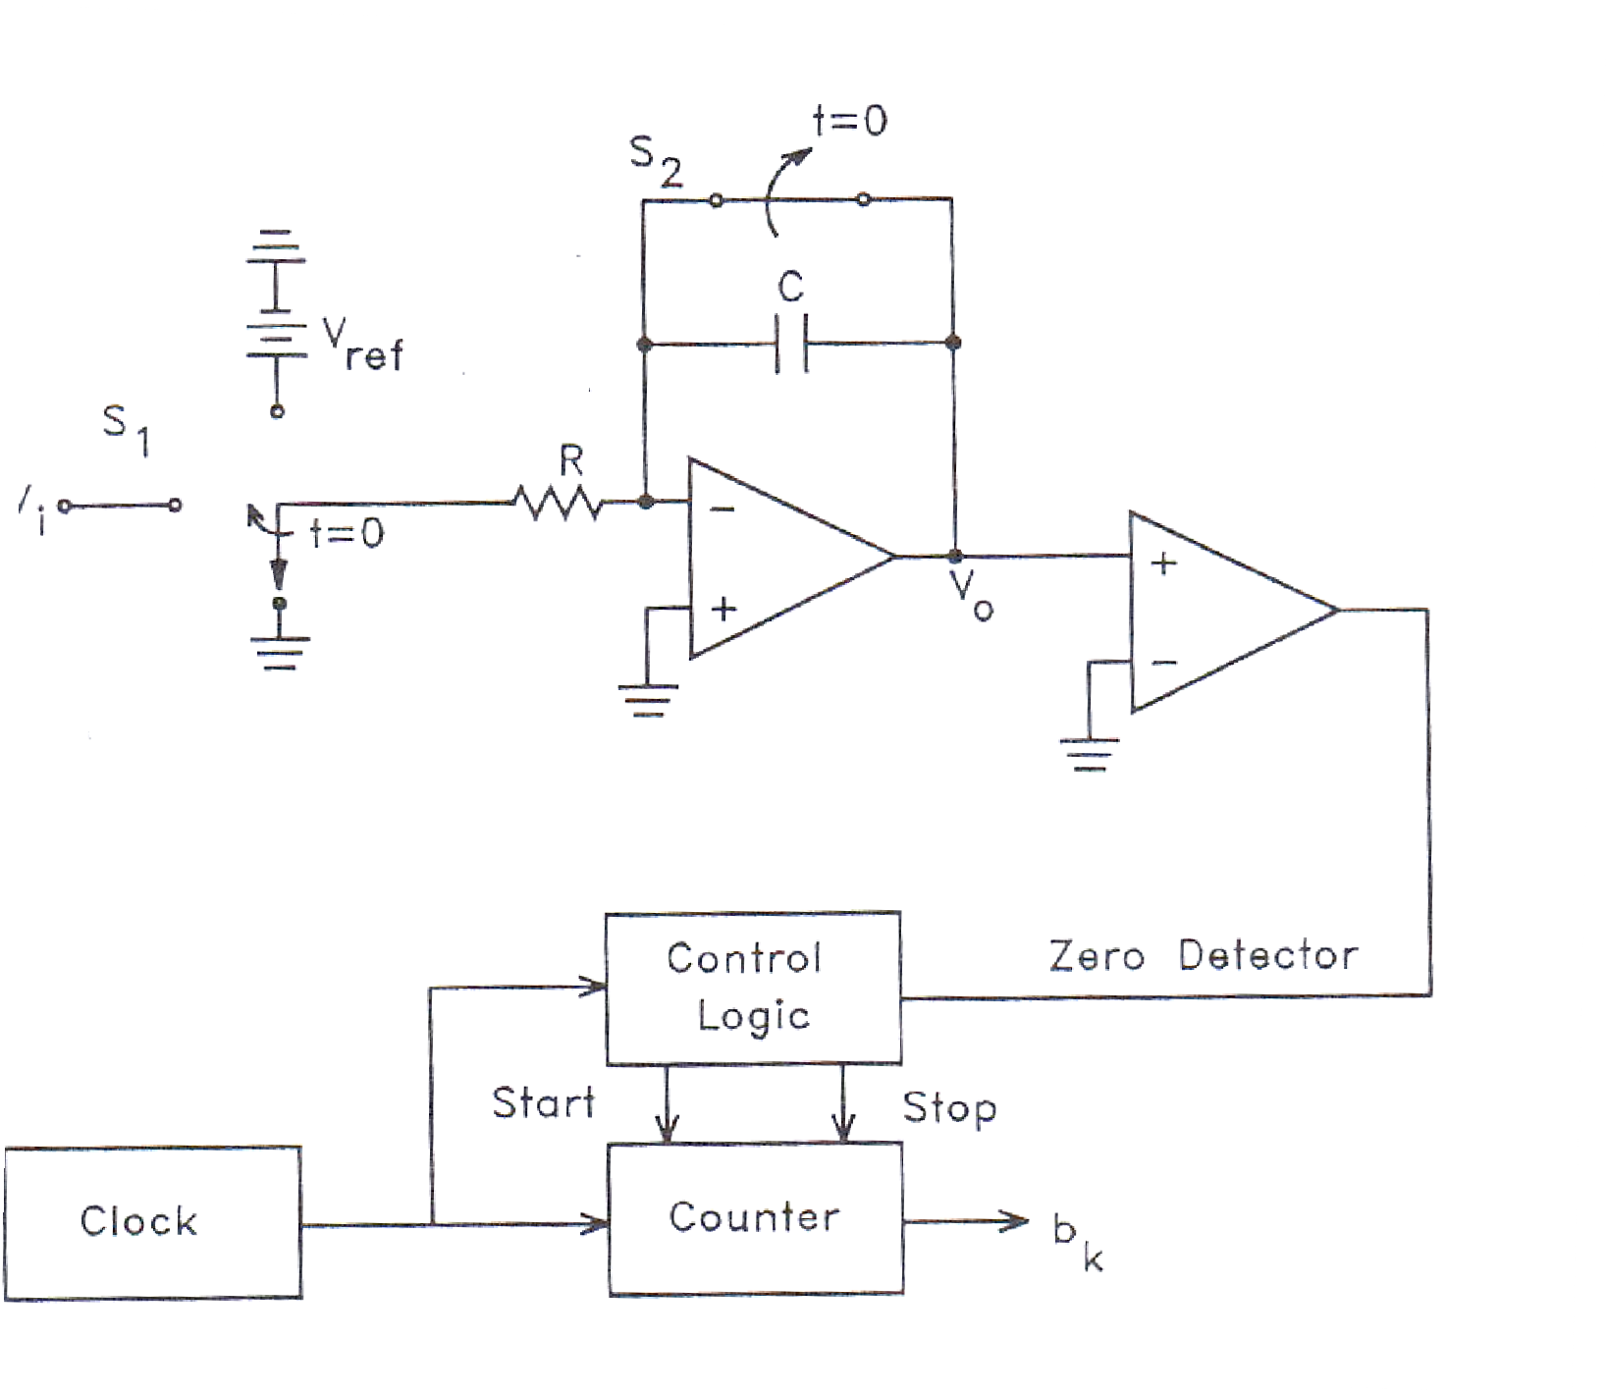
Dual-Slope type A/D Converter

Slide 59

V_{in}
t_{FIX}
t_{meas}
t
The sampled signal charges a capacitor for a fixed amount of time
By integrating over time, noise integrates out of the conversion
Then the ADC discharges the capacitor at a fixed rate with the counter counts the ADC’s output bits. A longer discharge time results in a higher count

Slide 60
Advantages
Input signal is averaged
Greater noise immunity than other ADC types
High accuracy
Disadvantages
Slow
High precision external components required to achieve accuracy

Slide 61
Successive-Approximation type A/D Converter
A Successive Approximation Register (SAR) is added to the circuit.
Instead of counting up in binary sequence, this register counts by trying all values of bits starting with the MSB and finishing at the LSB.
The register monitors the comparators output to see if the binary count is greater or less than the analog signal input and adjusts the bits accordingly.

Slide 62
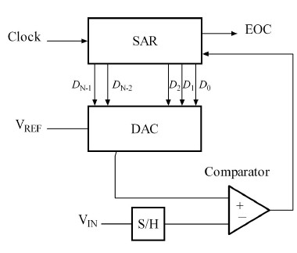
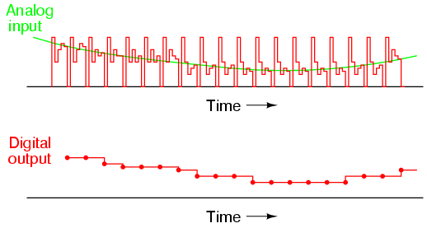

Slide 63
Advantages
Capable of high speed and reliable
Medium accuracy compared to other ADC types
Good tradeoff between speed and cost
Capable of outputting the binary number in serial (one bit at a time) format.
Disadvantages
Higher resolution successive approximation ADC’s will be slower
Speed limited to ~5Msps

Slide 64
ADC Types Comparison
Type | Speed (relative) | Cost (relative)
Dual Slope | Slow | Med
Flash | Very Fast | High
Successive Appox | Medium – Fast | Low
Sigma-Delta | Slow | Low

Slide 65
Application of ADC
ADC are used virtually everywhere where an analog signal has to be processed, stored, or transported in digital form.
Some examples of ADC usage are digital volt meters, cell phone, thermocouples, and digital oscilloscope.
Microcontrollers commonly use 8, 10, 12, or 16 bit ADCs, our micro controller uses an 8 or 10 bit ADC.

